Slide 1
TOCICO CONFERENCE 2008 TOC Games Learning How to Teach Systemic Improvement
Presented By: James R. Holt
Date: June 6-9, 2009

Slide 2
What is A Good Game?
Games should have a PURPOSE.
Good Games are QUICK.
Good Games have EASY SET-UP.
Good Games are FLEXIBLE.
Good Games deliver DEEP UNDERSTANDING.
Good Games have many OPTIONS.
Good Gamers include REFLECTION.

Slide 3
Summary of Game To Discuss
Dice Game Variability, Interdependence
Nickel Game Batches, Queuing, Efficiency
Dollar Game Priorities, Communication
Job Shop Game Buffer Management, Choke
Assembly Game Feeder Buffer, Bench Reserve
Alpha-Number-Shape Multi Tasking
Sixes Game Cutting Task Duration, Bench

Slide 4
Dice Game--Source: The Goal, The Match Game http://public.wsu.edu/~engrmgmt/holt/em530/Docs/DiceGames.htm
Purpose: Understand the negative impact of interdependency combined with variability.
Min/Max Participants: 5/6 on the line. More for monitors.
Min Set-ups: 5/6 fair die, 50+ tokens
Min Time: 5 mins.
Best Set-up.
Have a recording sheet for each person to record their goals and WIP for each of the ten days.
Discuss mean and variance of a die. Expectations of ten rolls shifting the uniform distribution to normal distribution.
Suggest “Rewarding” high performers.

Slide 5
Dice Game
Basic Instructions:
Set-up 5 with a fair die. Put cup of tokens at one end.
The play is for ten days.
Each day, the person nearest token rolls die and removes that number of tokens from the cup and moves them to between himself and the next person. The next person rolls a die and moves the lesser of the roll or the number of tokens available to before the next person in line. This continues for all five people. The end person puts the production for the day in a Finished Goods cup.
Anticipated Outcome: After ten days, 20 to 30 tokens will be in the FG cup; much less than 35. (Note: with ten rolls of a single fair die, the Mean=35, Standard Deviation 5.9, so <30 is expected 20%, <25 is 5%, <20 is 1%.)

Slide 6
Dice Game
Embellishments:
Rewards: If any person rolled 36 or more in ten rolls , they are recognized as Superior Performers. If anyone rolls 40 or more, they are Sustained Superior Performers.
Penalties: If the Plant produces less than 30 tokens in the FG cup, the Plant receives a WARNING!. Play the Dice Game again. If the Plant Receives two warnings in a row, then the plant must close.
Discussion Points:
Interdependence prevents the plant from taking advantage of the high rolls. Everyone feels the low rolls.
The amount of WIP left is the system belays the inefficiency of the balanced line.

Slide 7
Dice Game (DBR Option)
Options: DBR Dice Game.
Set-up: 5 un-fair die, 50 tokens for five players. The center player is the constraint. The center player has a modified die with only 18 dots (paint white-out on two dots on the 6 side and one dot on the 5 side) to average 3 (1,2,3,4,4,4).
The first two players and last two players receive a five sided die (us a regular fair die but roll again if the roll is a 1) with 20 dots.
The non-constraints averages 4 and have a 33% excess capacity over the constraint which only averages 3 per roll.

Slide 8
Dice Game (DBR Option)
Buffer Size.
The non-constraints minimum is two per roll.
Constraint’s maximum is four per roll. The paranoia factor? There is a potential problem of reducing the constraint buffer by two per day. How many days can we tolerate this? That is our paranoia factor.
Assume for starters three days of paranoia (a Buffer of six). Put six tokens just before the Constraint.
Each day, Everyone rolls, but the first non-constraint only moves tokens equal to the minimum of “The first non-constraint’s roll” or “The amount needed to replenish the Buffer to Six.” (This means the first day while there are six in the system between player 1 and the constraint, that the first players does not enter any new tokens on day one; the buffer is full with six tokens already.) If necessary, the Buffer size is increased by group consent.

Slide 9
Dice Game – Additional Comments
Having a longer line of six players dramatically reduces FG.
Continuing the play for a longer period of time (11, 12, 15, 20, or 30 days) illustrates the impact of the moving WIP but only provides limited improvement in FG over the 10 day period (as play goes on, the system acquires more and more WIP).
Interesting combinations can be made for complex lines with assemblies and splits or assigning multiple dies for some players.

Slide 10
Dice Game Record Sheet
 | Rolls | Remaining | Rolls | Remaining | Rolls | Remaining | Rolls | Remaining | Rolls | Added to
 | ! | Wip | 2 | Wip | 3 | Wip | 4 | Wip | 5 | FG
Day 1
Day 2
Day 3
Day 4
Day 5
Day 6
Day 7
Day 8
Day 9
Day 10
Totals

Slide 11
Nickel Game http://public.wsu.edu/~engrmgmt/holt/em530/Docs/NickelGame.ppt
Purpose: Demonstrate the difference between local efficiency and global efficiency in two plays.
Min/Max Participants: 3/20+
Min Set-ups: Ten large coins (nickels or quarters)
Min Time: 3 minutes.
Basic Instructions: First Play: Each person turns the coins from all coins from “All Heads up” to “All Tails up,” then slides the coins to the next person. A person calls out the time. Each person playing remembers the time when they pass the batch of coins. After everyone is finished, subtract the previous player’s completion time from your completion time to determine how long it took you to turn the coins.

Slide 12
Nickel Game
Expectation: After all have had a chance to turn the coins, start with the first person and ask completion time. Ask the next person the completion time and subtract the previous persons completion time. Everyone will have a completion time between 5 seconds and 10 seconds (finishing about 7*number of players; with ten players, it takes about 70 seconds).
Second Play: A new boss arrives and notices there may be quality problems where some coins were not turned over each time. This is unacceptable. A new policy is put into place that requires everyone to put one hand behind their back and turn coins with only one hand. To make up for the slowness, each coin may be passed immediately to the next person in line who can begin as soon as they have a coin. Play again until every one has flipped all ten coins.

Slide 13
Nickel Game
Expectation: In the second game, it is harder to be accurate on how much time it take for each person to flip the coins one at a time. They all start within just a few seconds and all end within a few seconds of each other. But, you can get the idea. It takes from 10 to 20 seconds per person to flip the ten coins; twice as long! However the time to complete all ten coins is about 4*number of players (for ten players its about 40 seconds).
Discussion: Lead the participants along. Talk about “how terrible the new system is.” Point out how the company cannot tolerate this new system because it is just too inefficient. It takes everyone twice as long to get their work done. Workers should rise up againse the new policy. There should be a STRIKE! Continue talking about how bad things are until someone points out they were able to finish all ten coins in half the time when all players were handicapped to only one hand. How is that possible?

Slide 14
Nickel Game
Learning Experience: Focusing on personal efficiency is not related to system sufficiency. Batching requires all to wait (they really didn’t notice the waiting as they watched with interest during the first round). It is important to KEEPING WORK MOVING; not sitting waiting in a batch queue.
Additional Comments: If someone argues that they just did not have enough work in the first game (batches), give them four batches in a row (ten nickels, then ten quarters, then ten nickels then ten quarters) and enjoy the chaos.
If you have enough coins, replay game two and continue play until the ending time of game one and see how many coins come out (will be 2 or 3 times more than the orginal ten).

Slide 15
Dollar Game http://public.wsu.edu/~engrmgmt/holt/em530/Docs/DollarGame.ppt
Warning: Play the Dollars Game AFTER learning from the Nickel Game.
Purpose: Demonstrate typical problems with misunderstanding and poor communications with planning in large organizations.
Min/Max Participants: 6/20+
Min Set-ups: A large number of coins of many denominations (at least 100 coins all blended together)
Min Time: 5 minutes

Slide 16
Dollar Game
Basic Instructions: Play is similar to the second game of the Nickel Game. Each player places one hand behind their back. The first player draws coins at random from the cup of mixed coins and passes the coin to the next person. Each person in turn turns the coin over and slides them to the next person who flips coins one at a time passing them to the next player immediately.
The only difference is the play stops (everyone freezes) every ten seconds (representing a week). NO OTHER INSTRUCTIONS ARE GIVING TO THE PLAYERS. PLAY STARTS IMMEDIATELY.

Slide 17
Dollar Game
Scoring: At the end of each week (10 seconds, 20 seconds, 30 seconds, …) a person acting as the customer examines the Finished Goods coins. The coins are arranged by denomination.
If there are four coins of the same denomination, they form a completed project and the customer announces, “Oh a finished project. Great, this one is worth <blank> amount.”
The amount for the project is determined by the denomination (4 pennies = $1,000, 4 nickels - $5,000, 4 dimes, $10,000, 4 quarters = $25,000, 4 dollar coins, $100,000. Use of foreign coins can provide a $1 million or $ 1 Billion or what ever.)

Slide 18
Dollar Game
After 30 seconds, if no one has asked yet, it’s time to slowly and somewhat quietly get the last person in the line to understand clearly that it take four coins of the same denomination to complete the project and the value varies depending upon the denomination. As soon as (and whenever) this clarity is given, play continues, “31, 32, 33,….”
Soon, someone will call out to only send high value denominations. Or, to ask, “We need one more quarter!”
At this point, you can stop the play and start discussion.

Slide 19
Dollar Game Discussion
Items for Discussion: The last person in the line is connected to the customer but did little to tell anyone else about the “Four Coin” projects.
The first person in the line was pulling coins as fast as possible but at random without regard to what was needed.
Individuals in the middle of the line were so busy flipping coins, they didn’t pay much attention to anything else.
What should have happened? Is it common for people to know the “value” of each piece of work they due? Or, do they know the overall priority of task? Does EVERYONE in the company know the planning system (planned order of release)? Or, the Customer connection (customer satisfaction)?

Slide 20
Dollar Game – Summary
Lead into a discussion of:
Knowing what projects are worth
Having a full kit
Responding to any Finicky customer (who wants Dimes NOW!)
How to Prioritize work for Workers on the Line. (May hold up a card with a picture of the priority coin needed or other).
After the Nickel Game and Dollar Game, players realize how they can quickly change their current systems to be FAST and PRIORITIZED.

Slide 21
Job Shop Game http://public.wsu.edu/~engrmgmt/holt/em530/Docs/JSGInstinfo.htm
Purpose: The Job Shop Game focuses on “Tying the Rope.” But, it is very versatile and can be used for many different functions
Min/Max Participants: 4/6 people per team
Min Set-ups: Eight sheets, each containing the Jobs 1, 2, 3, 4. A Tracking Sheet for reporting.
Min Time: 20 minutes for each short game, 35 min for two runs. 50 mins for three games. Or, 30 mins for one continuous game making the transition to “choke the release” about half way through.

Slide 22
Job Shop Game
Basic Instructions: 20 to 32 individual jobs are cut from the sheets (so there are equal number of each job type).
One person shuffles the jobs and releases one job each day (recording the day released). Four persons act as workstations. Each workstation can record one number (the number of the day) on only one of any of the jobs awaiting at that workstation each day The numbers are written in the first available slot requiring that workstations work (the jobs must be completed in order; you can’t work ahead of a preceding task). Each job type takes a different route through the four workstations. When all work on a job is completed, a recorder calculates the flow days and records a plot of when that job completed and a histogram of all jobs.

Slide 23
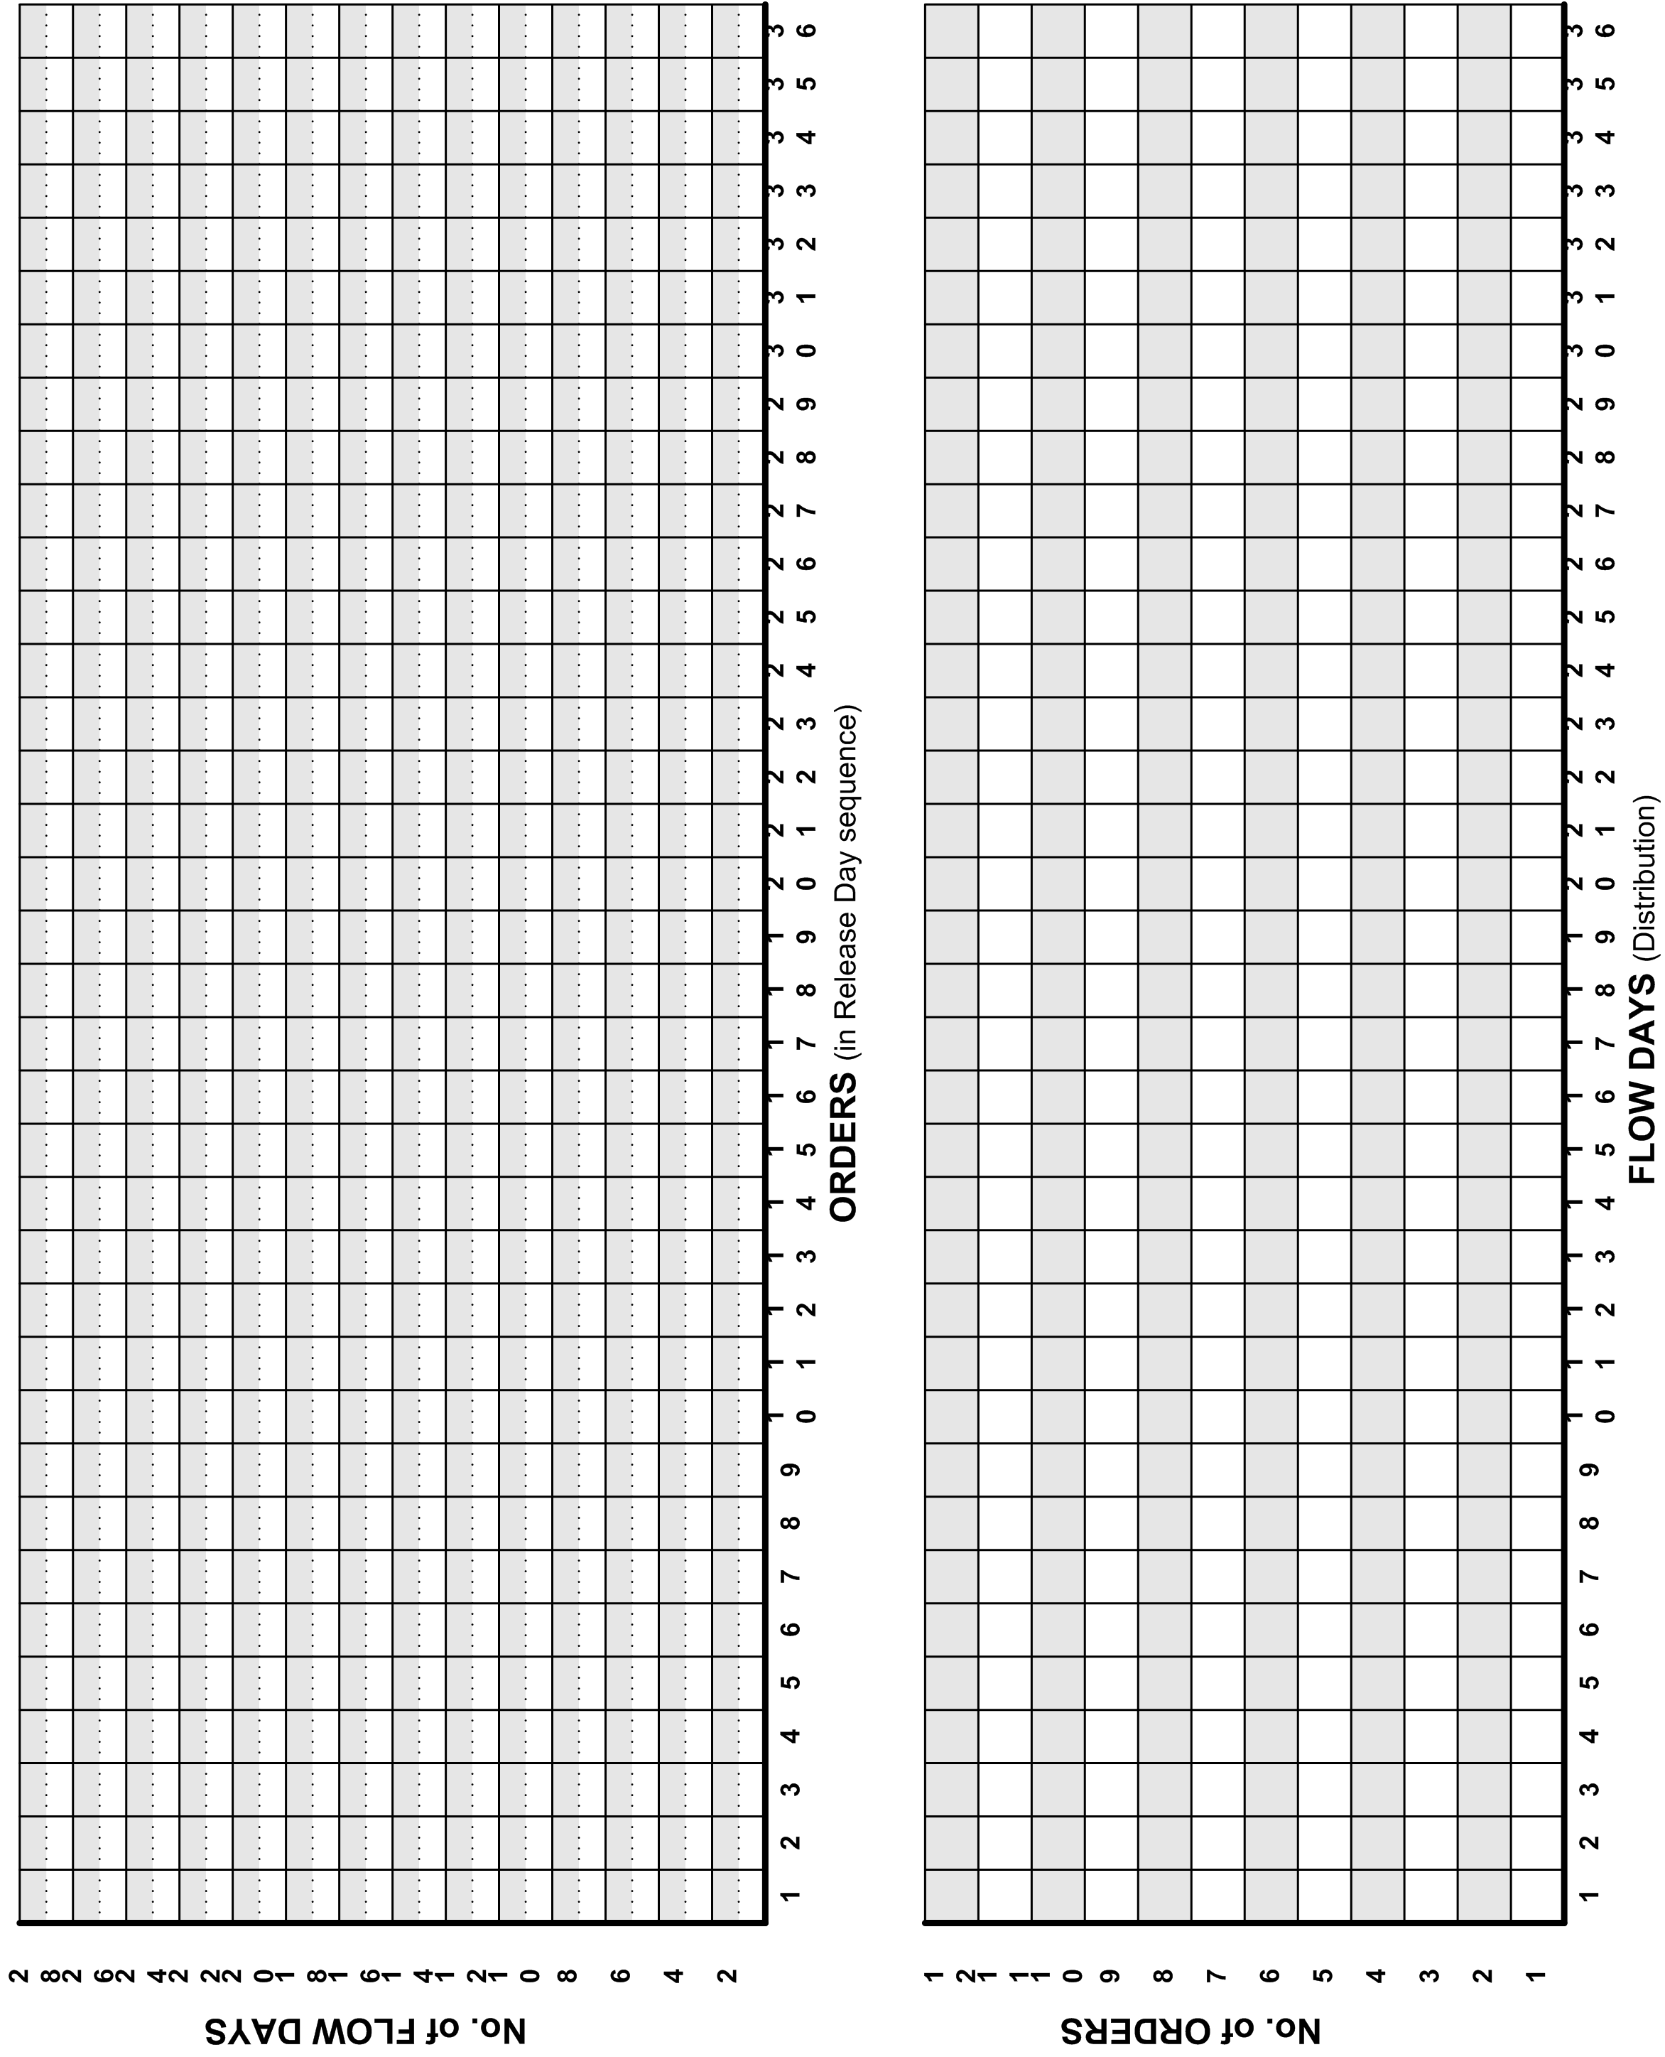
Job Shop Game Graphics

Slide 24
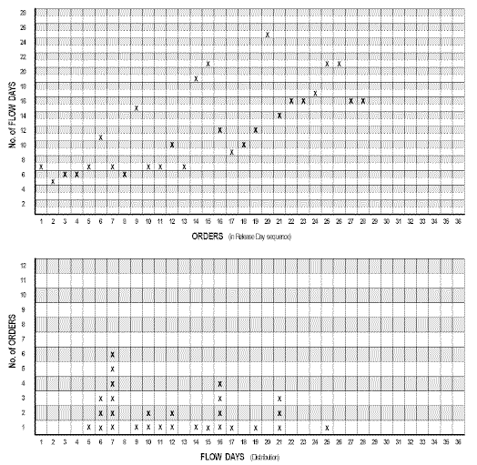
Job Shop Game Results
After 20 to 30 days of releasing one job each day, the flow time to gradually increases because, on average, there are six B tasks released each four days.
The plot looks generally like these.
Note the ascending trend with wide distribution.
Predictability of future delivery times are chaotic.

Slide 25
Job Shop Game
For the Second Game of the Job Shop Game, encourage the team to try to figure out an “OPTIMAL Schedule” for the release of work into the system (versus random shuffle).
This is mentally challenging exercise that eventually produces about the same end result. The Job Shop Game is determinist. The only variable in the system is which job is released when. It take about the same amount of time to get all the jobs done from start to end.
Some teams will be cleaver but it doesn’t produce comfortable results; results you can expect to control. Job shops normally can’t control customer demand.

Slide 26
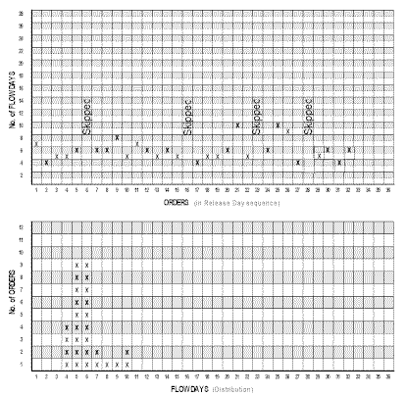
Job Shop Game - DBR
The Third Game applies DBR principles.
Jobs are shuffled and released one job a day just like before (random). But when the selected Buffer Size is achieved, no work is released unless the work in the buffer is below the planned buffer size..
The Constraint Buffer includes ALL UNCOMPLETED B Tasks released to the system no matter where they are located. Buffers of 4,5,6 are provide different experiences.
The results appear very predictable.

Slide 27
Job Shop Game Discussion
Notice that when jobs are not released (Because the Constraint Buffer is full), work is delayed. The jobs are delayed so the release of the work coincides with the capacity of the constraint.
While the work is not completed any sooner (it takes about the same time to complete all the work when the jobs are not released daily as it did when the jobs were released daily; its deterministic), it’s very predictable. And, the time from start (release date) to finish is very fast.
These two exceptional results (predictable and fast) are the result of tying the rope. These two elements form a significant competitive advantage.

Slide 28
Job Shop Game – Continuous Play
Embellishments:
Continuous play. An option is to play for 20-25 days and then ask a designated CEO of the system, “Should you continue to release new work to the system?”
Keep discussing until the CEO decides, “No.”
Then, each day ask, “Should we release a job today?”
After a few days, the discussion becomes, “You don’t what to decide this question every day. What should the policy be?” Insightful discussion continues.

Slide 29
Job Shop Game – With Variability
More Embellishment:
People work in Project Environments need to see variability. This is easy to simulate by giving each workstation a single die. Each day, they roll the die. If they roll 1, they have a bad day and cannot write a number. If they roll 2, 3, 4, 5, it’s normal and can write one number per day. If they roll a 6, it is a good day and can write two number per day (if they have two jobs to do).
The added variability doesn’t change any of the curves. But, it is very effective at getting project people to buy in to the “choke and release” process necessary for effective Critical Chain Project Management.

Slide 30
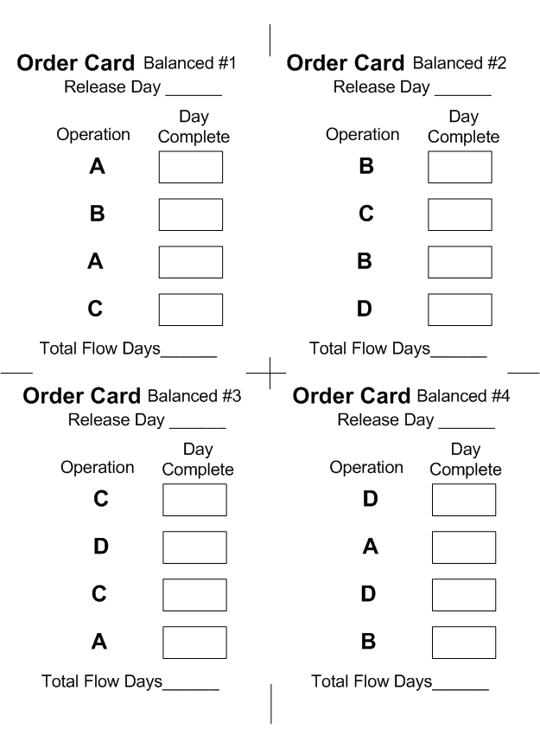
Job Shop Game – Balanced Line
There is a set of Job Shop Cards that have equal numbers of tasks for A, B, C and D. But, due to the routing, the precedence requirements of the work, delivery become very much like the constrained line (until there is significant WIP awaiting at each workstation, meaning the flow time is very long much like the real project world).
The solution to this balanced line is the same. Tie the Rope. You may use any workstation as the control mechanism or the total in the system acting as a virtual drum.

Slide 31
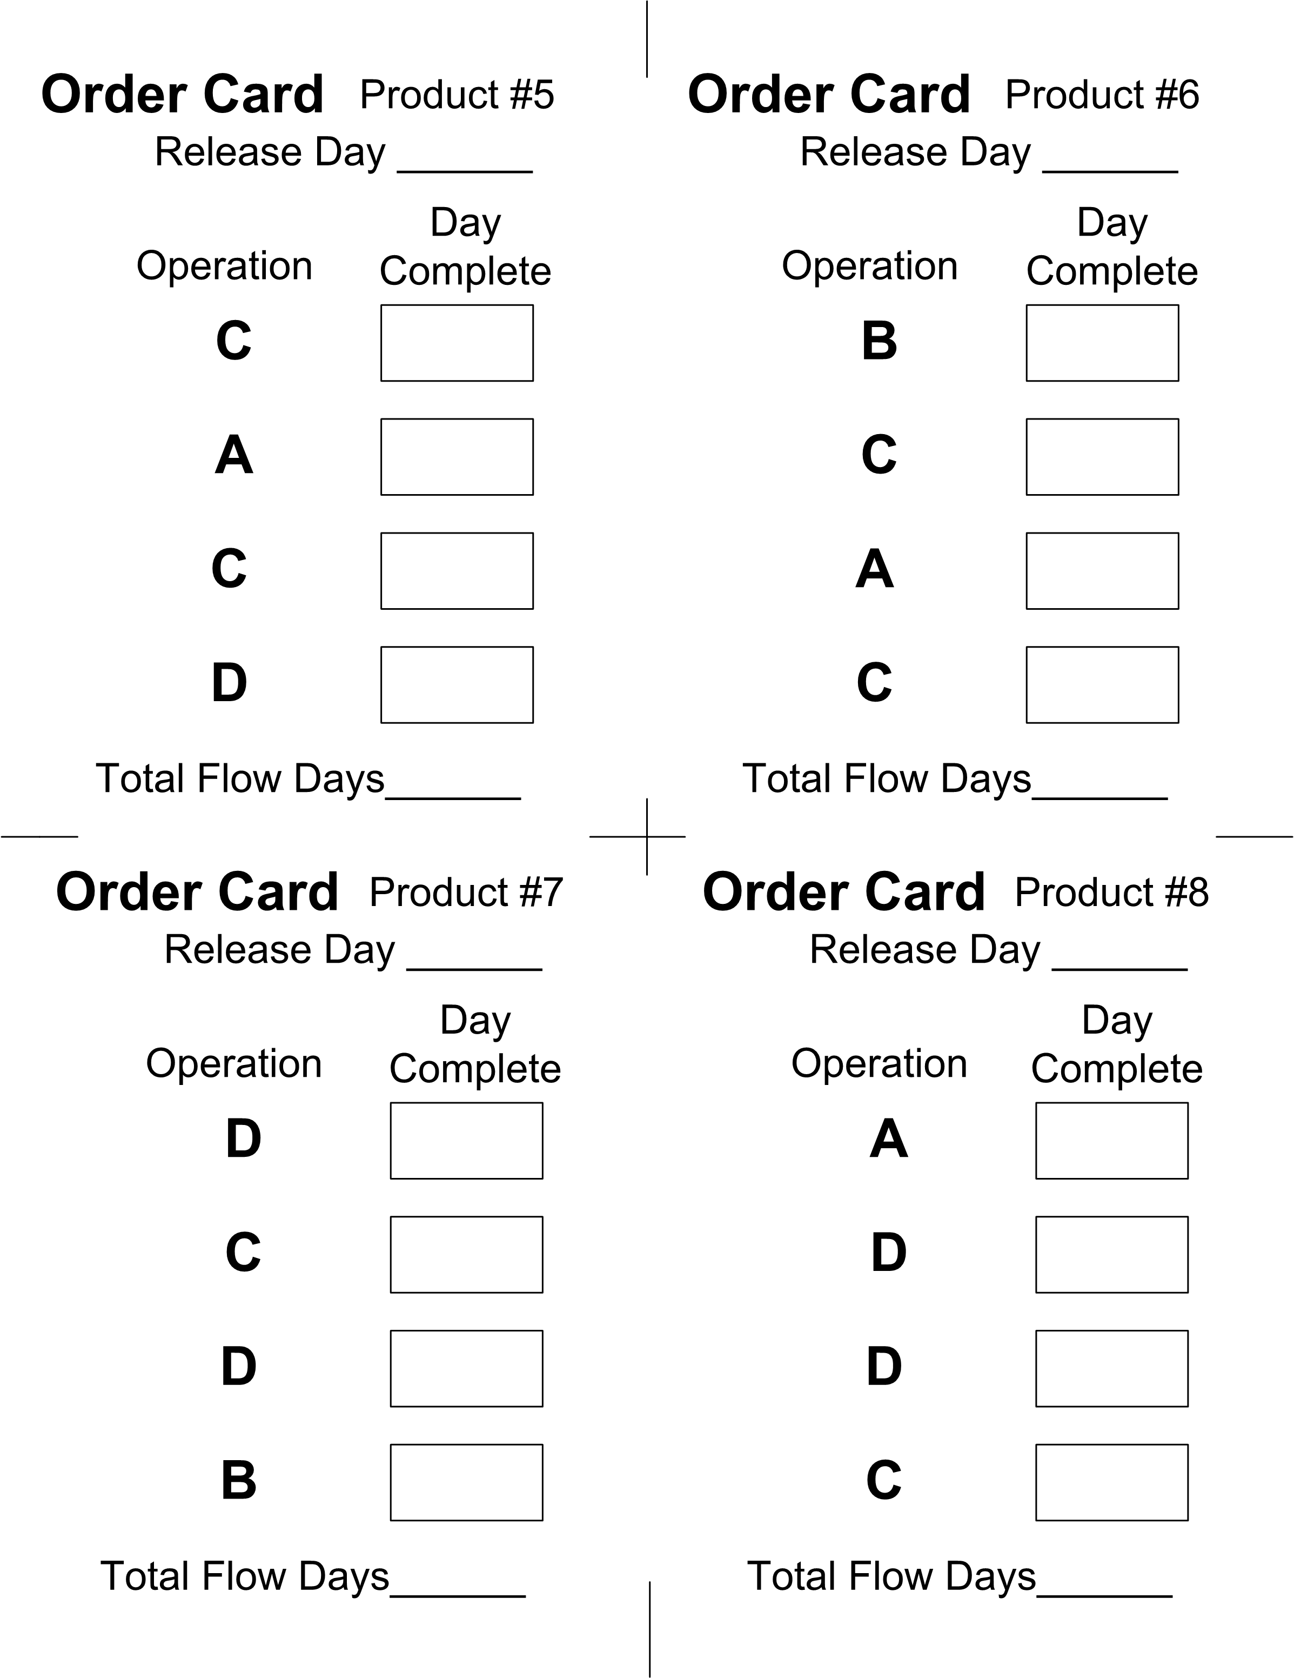
Job Shop Game – Dynamic Buffering
Additional Embellishment:
By playing the traditional Job Shop Game, for about 15 days (with the DBR approach) and then substituting a new Job #5 for each Job #2 as it comes until five Job # 5 have been released. This creates a new product mix that moves the constraint to Workstation C. Allow this to happen until the Buffer is inadequate to protect B.
Then, discuss increasing the Buffer size to protect the system during this “temporary change in product mix.”

Slide 32
Job Shop Game - Financials
Assigning a Raw Material Cost and Sales Price to each job type brings a different dynamic to the Job Shop Game.
Adding a finicky market demand by type can create havok.
Determining “T/constraint Day” helps players get a better understanding.

Slide 33
Assembly Game http://public.wsu.edu/~engrmgmt/holt/em530/Docs/Assembly.ppt
Purpose: Demonstrate the difficulties of Assembly and the benefits of Feeder Buffer and the Reserve Bench.
Min/Max Participants:6/8
Min Set-ups: Each participant has a coin
Min Time: 5 Mins
Basic Instructions: You have a process that requires the assembly of six components. It’s critical that the assembly happen on time. Each component is produced by one participant (six participants required). There are six days for participants to produce their component for the assembly.

Slide 34
Assembly Game
Basic Instructions (continued): Each participant is to produce their component by flipping a coin. The coin can be flipped only once each day. When two heads are achieved, the component is completed.
Understanding: While the probability for an individual to flip two heads in six flips is high (over 90%), when there are six individuals and the assembly cannot happen unless all six are available, there is about a 50% chance of failure.
Play the Assembly game several times until there is a failure. When there is a failure, Fire everyone and close the plant (this is the definition of Critical).

Slide 35
Assembly Game-Feeder Buffer
It’s not nice to close the plant. There must be a better way.
One way is to offset the assembly with Feeder Buffers. Have five of the individuals start on Day 1 and one individual starting on Day 4. Now, the assembly must happen on Day 9 (six days plus three day buffer).
Play the game several times and record the number of days the early start activities exceed their six days.
The success of assembly on Day 9 is much increased (85%).
Prove this by playing several times.
Feeder Buffers

Slide 36
Assembly Game – The Bench
Unfortunately, in the Assembly Game, if the assembly is missed, the plant closes.
The Feeder Buffer solution still relies on one critical component (starting on Day 6) to complete on Day 9. It’s possible that process may fail. You can point out this situation by suggesting, “What if YOU (pointing to a late component) had been the critical component starting on Day 4? Would we have completed on time?”
This is again unacceptable. The traditional solution is to give every component TEN DAYS to flip two heads, a very expensive and slow process. There must be a better way. Yes, “The Bench.”

Slide 37
Assembly Game – The Bench
In the real world, “The Bench” should be made up of experts who can flip coins get a head much often than the average person. But, for this case, just ask for two normal people to act as The Bench.
Now, play the game with The Bench available to help if needed.
The game starts with the six players flipping coins each day starting Day 1.
On Day 4, if a player has not achieved two heads (over the first three days), one or more of the Bench players flips a coin along with that player on Day 4. The number of heads rolled by the player and the Bench are both counted.
The Bench
The Bench only watches during the first three days.

Slide 38
Assembly Game – The Bench
There are only two on the Bench. It’s possible that three of the basic six players have not flipped two heads in the first three days. The two on the Bench should help these with the least heads on Day 4.
On Day 5, the results of Day 4 are examined and if the assembly has not been made, The Bench is used again in the same manner as before.
This continues on Day 6 if needed.
The results are good. The Assembly occurs at the end of Day 6 a high percentage of the time (95%).
To increase to absolute certainty, those of the basic six players who flipped their two heads in the early days of the process become additional members of The Bench and become available to help anyone in need (99+%).

Slide 39
Assembly Game – The Bench
The most important thing is to complete the assembly by Day 6.
Play the game several times recording how many times a member of The Bench had to flip a coin. The results are surprising. The Bench reserve provides significant protection with minimal flips of the coin.
In practice, it’s best to rely only on the two on The Bench. Let the basic six participants continue their own work, knowing there is a safety buffer provided by The Bench.
The Bench also is only less than 50% of the time, leaving the Bench to use it’s expertise to watch and direct improvements to the system (about 50% of the time).

Slide 40
Alpha-Number-Shape Game http://public.wsu.edu/~engrmgmt/holt/em530/Docs/AlphaNumberShape.ppt
Purpose: To show the devastating impact of multi-tasking.
Min Participants: 1
Min Set-up: 1 piece of paper per person
Min Time: 2 Mins
Source: A variety of the Alpha-Number-Shape Game comes from several sources (Alan Barnard, ProChain Solutions, Afinitus, and probably others). We thank all those who contributed to this game which is documented here.

Slide 41
Alpha-Number-Shape Game
Instructions: Give each player a single sheet of paper that can be used on both sides.
Instruct the players they will be timed to do the process. The process is simple. They will write on the paper the letters A through Z, the numbers 1 through 26 and repeat the shapes until there are 26 shapes.
The first time, they will write row by row the letter, number and shape all the way across the row before starting the next row as follows: Continuing down the page until all the letters, number and repeating shapes are written.
A
1
B
2
C
3
D
4
.
.
.
.
.
.
.
.
.

Slide 42
Alpha-Number-Shape Game
After the first Row-by Row trial, have each person record at the top of the page the time it took to complete the simple process using the Row-by-Row approach.
Repeat the same process on the opposite side of the paper only this time, do the work Column by Column, a Column of Letters first, then next to it a Column of numbers and lastly a Column of the 26 repeating shapes (circle, square, triangle).
Record the time to complete the second time doing the same process.
Compare the differing times.
A
1
B
2
C
3
D
4
E
5
.
.
.
.
.
.
.
.
.

Slide 43
Alpha-Number-Shape Game
Discuss the participant’s feelings and attitudes about the two different approaches to the same work.
There is often significant frustration and quality problems with the first approach. The difference is much more than speed.
Ask the participants, “If you have to do this again, how much would you pay to not have to do it the first way.”
Recognize that actual work requires much more mental processing that this simple game.
A
1
B
2
C
3
D
4
E
5
F
5
G
5
H
5

Slide 44
The Sixes Game http://public.wsu.edu/~engrmgmt/holt/em530/Docs/SixesGame.pdf
Purpose: To highlight the underlying cause of the beta distribution for individual project tasks and to give confidence to those scheduling aggressively.
Min/Max Participants: 10/20
Min Set-up: A fair die for each participant.
Min Time: 5 Mins.
Background. Project Management tasks are “low first pass yield” events. The first try is rarely successful and repeated efforts are required to complete the task. Rolling a fair die has a 1/6th chance of rolling a Six. The chance of not rolling a Six in the first attempt and rolling a Six on the second attempt is (1-1/6)*(1/6). The chance of not rolling as Six in two rolls and then rolling a Six on the third roll is (1-1/6)*(1-1/6)*(1/6). And so on forming a negative exponential distribution.

Slide 45
The Sixes Game- Background (cont.)
A cumulative probability distribution Rolling a sixof negative exponential of the number of trials to roll a Six follows closely a beta distribution with Alpha=2 and Beta =10.
Hence the Sixes Game is a very good parallel to individual task performance (and it is close enough to reality for what we will learn).

Slide 46
The Sixes Game
Set-up: Give each participant a fair die. Ask, “How many sides? What is the chance of rolling a Six on the first roll? How many times will you have to roll to be sure an get a Six?”
Have everyone roll until they get a Six; counting their rolls. Record a Histogram of individuals rolls to get a picture of the negative exponential nature of the process. It takes 40 to 60 trials to get a good picture. So, you may have to have 10 participants try to roll a Six 4+ times.
x
Median is 3.5
x
x
Mean is 6
x
x
x
x
x
x
x
x
x
x
95% is 16
x
x
x
x
x
x
x
x
x
x
Maximum is 40+
x
x
x
x
x
x
x
x
x
x
x
x
x
x
x
x
x
x
x
x
x
x
x
x
x
x
x
x
x
x
1 2 3 4 5 6 7 8 9 10 11 12 13 14 15 16 17 18 19 20 21 22 23 24 25 26 27 28 29 30

Slide 47
Sixes Game
Once a rough histogram of the process is clear, we can start the Game.
Tell everyone (assume ten people playing), “We are doing a project. I need your estimates on how long it will take you roll a Six. We want to finish the project on time so be accurate in our estimate of how many days (rolls) it will take you to finish your task.”
To get the first “Safe estimate”, suggest, “Each of you put $5 on the table. If you finish (roll a Six) within your estimate, then I will pay you $5, if you don’t, I will take your five dollars.” While this is a 50/50 bet and they should estimate the median, they almost all say 16 or more. Try to find a safe estimate that everyone will would accept. You can say, “How many will play if have 20 days? 19 day? 18 days? 17? 16?” until a few people don’t want to play any more.

Slide 48
Sixes Game
Help the group understand what having a Safe Estimate means on the organization. Multiply the general groups ‘safe estimate’ by the number of people in the group and ask, “If ten people have estimates of 16 rolls, that’s a project of 160 days. I can’t sell that. I need it shorter. How many of you will still participate in a 150 day project (meaning 15 days each)? A 140 day project? A 130 day project? A 120 day project?”
At some point, people start to take their $5 off the table and won’t participate. At that point say, “Ok, I need all of you so, let’s stop at (for ten people, this is usually about 130) days. I’ll try to sell this to the boss.”

Slide 49
Sixes Game
You turn around and say, “Sorry. It’s been nice knowing you, but you are all fired. The boss won’t do the job if it takes 130 days. I guess we can all go home!”
Then explain the Boss requires max of 100 days (again here I’m using ten people).to be competitive. You ask, “Can we do this in 100 days and keep our jobs? Put away your $5. I’ll take the risk. Let’s see if we can do it.”
Each person rolls until they get a Six. Some one will be rolling much longer than the rest of the group. Make light hearted fun about that person; a very smart person who just can’t roll dice. By now, everyone understand it is not the individual IT’S THE SYSTEM?

Slide 50
Sixes Game
The total of the rolls from ten participants will be about 50 plus/minus 15. This is clearly less than 100.
“Must be a fluke! How can we do this when we really needed 160 days to be safe?”
Do it again. The second time has about the same results.
Discussion of estimating (for ten people) an aggressive estimate of 50 with a project safety buffer of 25 allows team to actually offer 75 days for the project and always deliver on time.
They can bid on 100 days and offer to pay a 5% penalty per day if they are late and still be safe. (Yet, no competitor would do it).
Or, offer to the customer to deliver in 75 days for double the price and include the 5% penalty. (Note: with this offer, if you deliver on day 85, the customer ends up paying the same price as for the 100 day bid. Now, isn’t that an un-refusable offer to person needing something quick?)

Slide 51
Sixes Game-Changing the Curve.
Embellishments: One of the big problems with the Beta Distribution is the Tail to the right. It’s possible that a single task can jeopardize the whole project.
The solution is to have a Reserve Bench of 10% to 20% of the players. With ten players, the Bench is one or two die.
As the game progresses, after day 5, any person who has not rolled a Six yet can take a die from the bench and roll two die together.
When the Bench die is not longer needed, it’s returned to the Bench.
Play this embellishment and see how much reduction you get in the average completion.

Slide 52
Sixes Game-Effectiveness of the Feeder Buffers
Insights: On thing that is a bit more difficult to play is having a parallel task for each task in the chain.
For nine people, split them so four are feeder tasks and five are the main line.
First, do the traditional schedule with each task estimating 16 days. This means the four feeder tasks start on Day 0, 16, 32 and 48 and the project hopes to finish by 80 days.
Completing in 80 days happens only about 2/3rds of the time.

Slide 53
Sixes Game-Effectiveness of the Feeder Buffers
Changing the operation to an aggressive schedule of 8 days changes the system. The project won’t be done in 40 days. It needs a 20 day buffer. Promise to deliver in 60 days.
With the CCPM schedule the feeders task are also estimated at 8 days with a four day feeder buffer. This means the four feeder tasks start on Day 0, 4, 12 and 20 days. The project (with the same dice process) easily finishes by 60 days.
Note the early feeder chains often causes Critical Chain penetration, but the later feeders don’t (with CCPM, more feeder buffer safety is added by the algorithm towards the end of the project, just when you need it).

Slide 54
Other Games of Merit
Bead Experiment – Developed by Tony Rizzo to demonstrate impacts of multi tasking. http://public.wsu.edu/~engrmgmt/holt/em530/Docs/BeadExperiment.ppt
Supply Chain Game – Supply chain of ten independent business units. Good for intro to TDD and IDD. http://public.wsu.edu/~engrmgmt/holt/em530/Docs/SupplyChainGame.ppt
Bean Factory -- TOC Replenishment Game teaches VMI http://public.wsu.edu/~engrmgmt/holt/em530/Docs/Bean-VMI-Game.pptx
Ice Cream Game – Automated interactive game where players are blind to the rest of the chain, yet still dependent. http://public.wsu.edu/~engrmgmt/holt/em530/IceCreamGame.htm

Slide 55
About James Holt
Dr. James R. Holt, is a Clinical Professor of Engineering Management at Washington State University focusing on the delivery of the best management technologies. He was a Principal Consultant with Management Advisory Group, Inc. and a Certified Associate of the Avraham Y. Goldratt Institute. He served as Department Head, Engineering and Environmental Management at the Air Force Institute of Technology, Wright-Patterson AFB, Ohio before he retired from the Air Force with 20 years in engineering, computer and technology management. Dr. Holt has taught at the graduate level 18 years and has advised 85 engineering student theses and dissertations on a wide variety of topics. He lives in the Portland, Oregon area and is active with professional and community organizations. Dr. Holt is certified in the TOC Thinking Process, TOC Operations Management, TOC Project Management and TOC Holistic Strategy by the Theory of Constraints International Certification Organization and serves as Chairman Elect of TOCICO (Theory of Constraints International Certification Organization). He is happily married to Suzanne for 40+years; they have five children and eleven grandchildren. http://etm.wsu.edu/holt/

