Slide 1
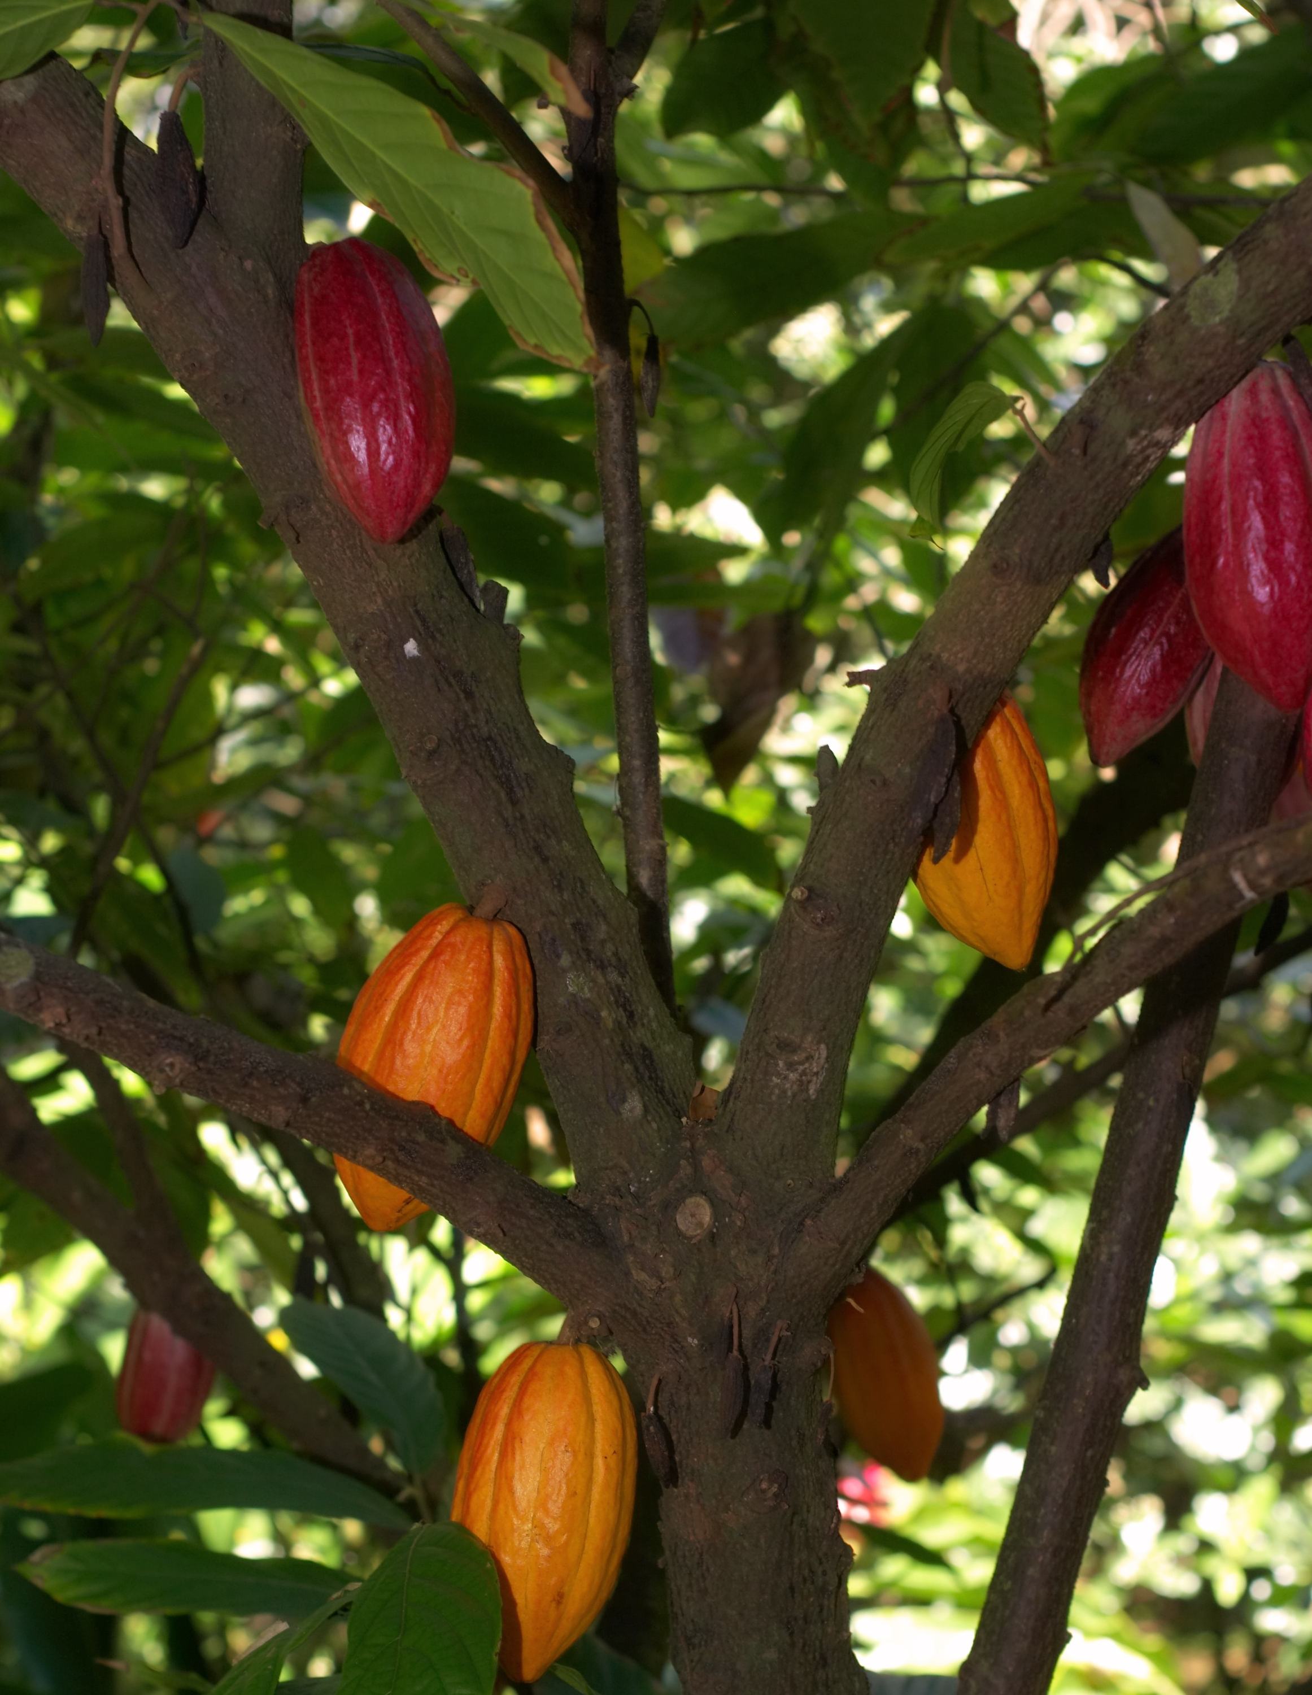
Natural selection and disease resistance in the cocoa tree
Joel T. Nelson, Damilola Olabode, Shawn Trojhan

Slide 2
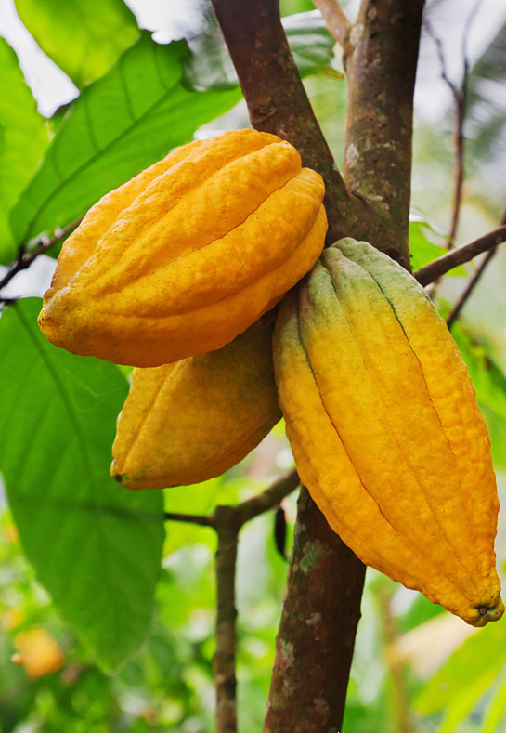
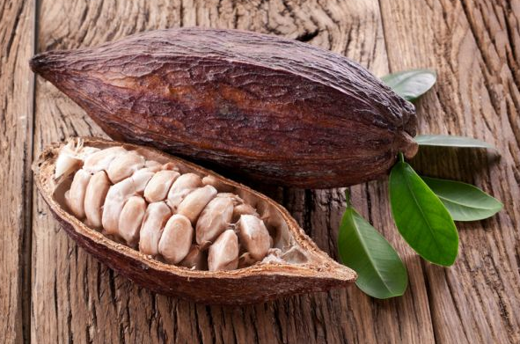
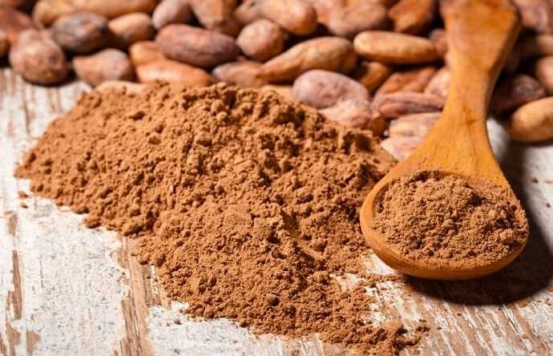
Theobroma cacao “the food of the gods”
Amazonian tree that has been cultivated for the production of cocoa
Originally, two main genetic clusters
Criollo and Forastero
Worldwide chocolate production
Criollo = 5%
Forastero = 80%
Trinitario (Criollo/Forastero hybrid) = 15%
Poor agronomic performance and high susceptibility to diseases, hybridization between Criollo and Forastero to increase yield and disease resistance

Slide 3
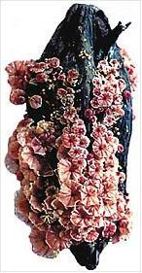
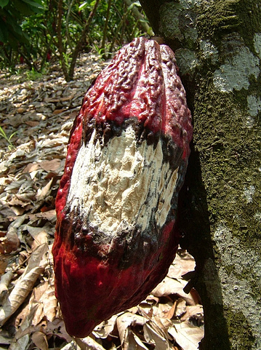
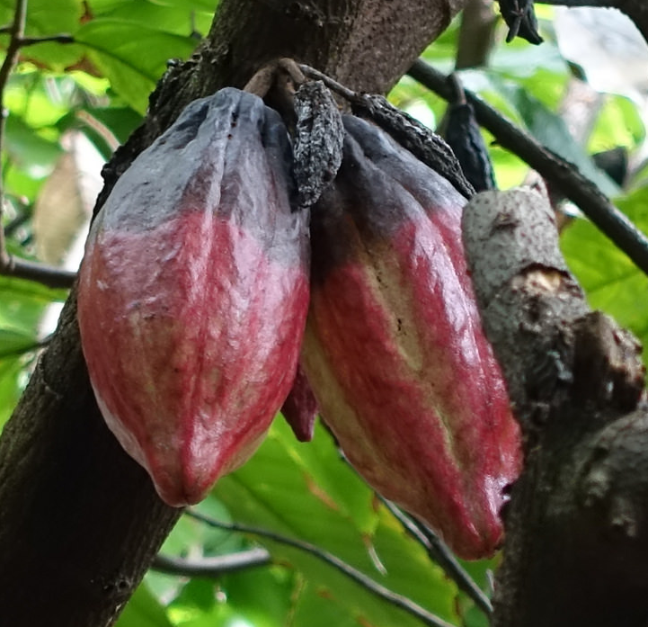
Disease trilogy in T. cacao
Cacao is highly susceptible to numerous diseases
Witches’ Broom
Frosty Pod Rot
Black Pod Rot
Criollo has become significantly more susceptible to these diseases.
Is selection acting on disease resistant genes in cacao populations?
Notes:
So things brings up a really interesting question in terms of disease resistance. More specifically, is selection…..

Slide 4
Step 1: Identify regions of the genome that are under natural selection
= neutral mutation
= beneficial mutation
Step 2: Identify the specific genes found within these regions.

Slide 5
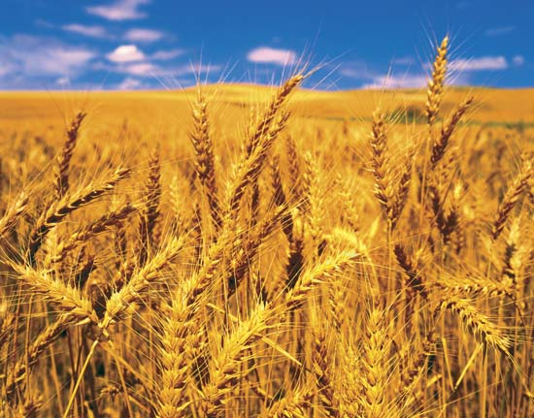
What is the goal?
What can the detection of selection tell us?
Genes that are under environmental pressure
Becoming locally adapted
How can identifying selection help with annual chocolate yields?
Assume we find disease resistant genes under selection
Effective management methods
Allocation of farming resources
Indicates which populations are less susceptible to infections
Breeding programs
If a population becomes more resistant, mortality rates decrease, thus, increasing annual chocolate yields.
Have be applied to many other study systems
Notes:
For the first bullet, mention something about an increase in fitness with local adaptation.
Just say “lets think about disease resistance” after the second main bullet instead of writing it.
Should I include examples?

Slide 6
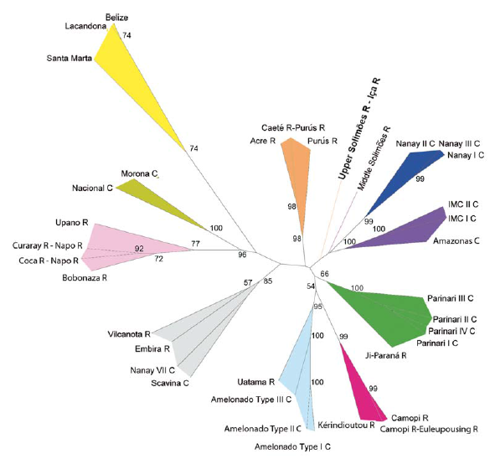
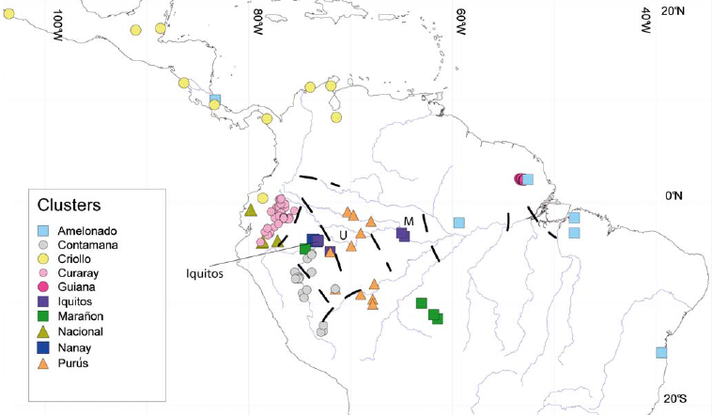
Genetic clusters of Theobroma cacao
Analysis of 106 microsatellite markers support 10 genetic clusters
Motamayor et al. 2008

Slide 7
Methods – sample locations and usable positions
73 Genomes
Criollo
N = 4
Guianna
N = 5
N = 10
N = 9
Curaray
Nanay
Contamana
N = 7
N = 9
Nacional
Iquitos
N = 4
Purús
Marañon
N = 6
Amelonado
N = 14
N = 11
Removed all singletons
Range of usable positions in the genome
Removed all fixed sites
Removed missing data
44,995 mutations
Criollo/Curaray
1,255,921 mutations Iquitos
Biallelic SNPs

Slide 8
Methods: Detecting selective sweeps
XPCLR
SweeD
OmegaPlus
uses 2D SFS (referenced population)
uses 1D SFS and demography
patterns of linkage disequilibrium among SNPs
XPCLR
SweeD
OmegaPlus
overrepresentation of genes/function in selective sweeps
Blast2GO

Slide 9
Methods: Multivariant data
Use multivariant analyses to identify putative selective sweeps
How to summarize the data?
How to identify outliers is multivariant space?

Slide 10
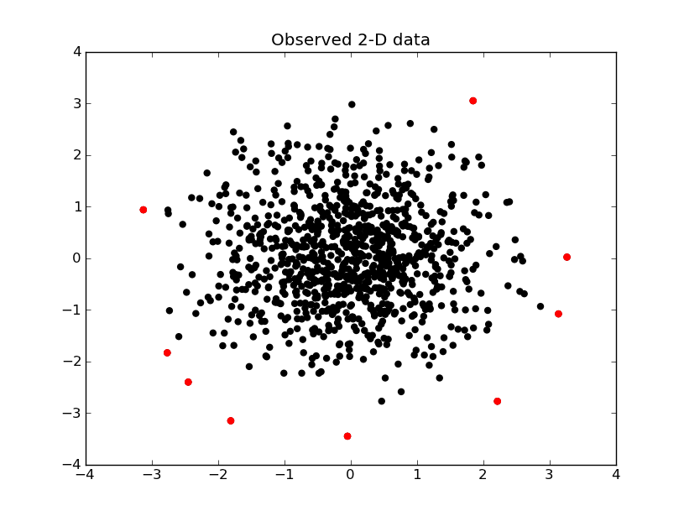
Methods: Multivariant data
Mahalanobis Distance: measure of the distance between point X_{i} and X (the number of standard deviations from the mean).
Main issue with Mahalanobis distance: as sample size increases, outlier signals are lost/less prominent.

Slide 11
Methods: Multivariant data
Ways to circumvent this issue:
use other methods to identify outliers (e.g., MINOTAUR)
Harmonic mean distance
Nearest neighbor distance
Kernel density deviance
change how the multivariant data are transformed and decomposed (e.g., eigenvectors and eigenvalues)

Slide 12
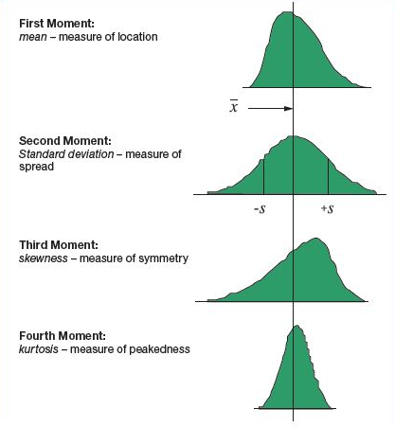
Methods: Multivariant data
Invariant Coordinate Selection (ICS): decomposition of multivariant data into invariant components with corresponding eigenvectors and eigenvalues.
Similar to PCA except ICS relies on the decomposition of two scatter matrices instead of one
Scatter matrices use different moments of the distribution to create eigenvectors and eigenvalues
Cov_{X1,X2} (PCA) vs. Cov_{X1,X2} and Cov4_{X1,X2} (ICS)

Slide 13
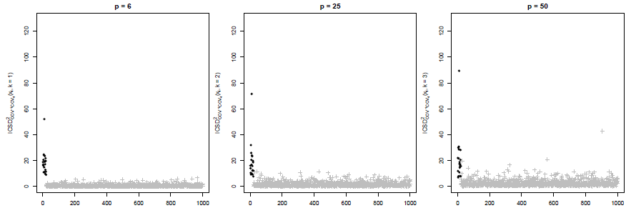
Methods: Multivariant data
Invariant Coordinate Selection (ICS): decomposition of multivariant data into invariant components with corresponding eigenvectors and eigenvalues.
ICS Distance = Euclidean distance = straight line distance between any two given points (X_{i} and X)
Euclidian Distance

Slide 14
Results: Detection of selective sweeps
Are there putative regions undergoing selective sweeps?
35 regions of the genome were consistent among all three methods
3843
7789
8543
Population | Sweeps
Criollo | 2
Curaray | 2
Iquitos | 9
Purus | 0
Maranon | 6
Guianna | 2
Nacional | 1
Amelonado | 7
Contamana | 1
Nanay | 5
1027
35
273
1149
XPCLR
SweeD
OmegaPlus

Slide 15
Results – Regions under selection (step 1)
Total = 4,430 regions

Slide 16
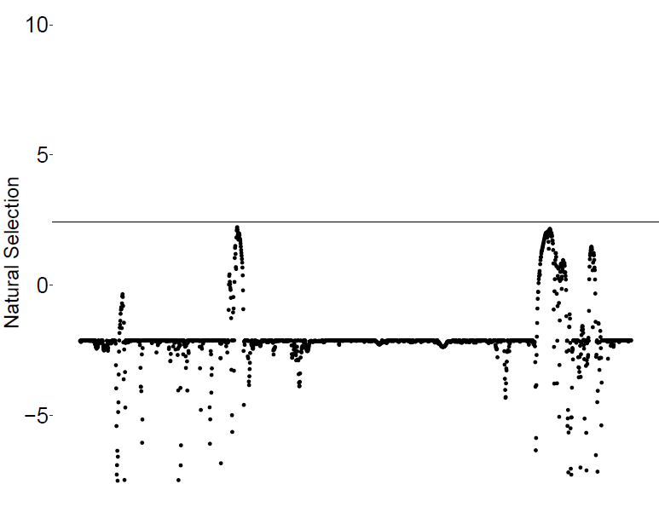
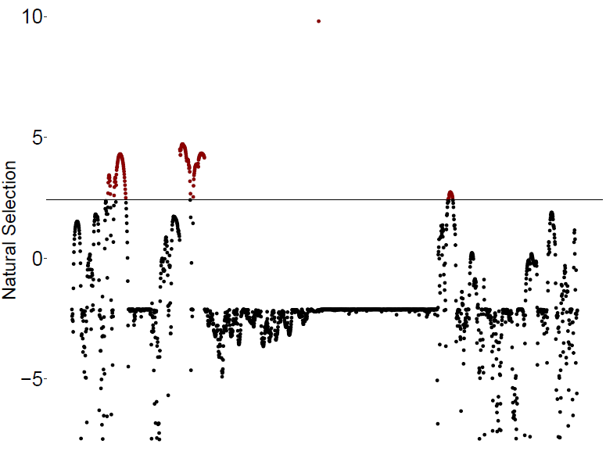
Results – Regions under selection (step 1)
Amelonado
Chromosome 1
Chromosome 6

Slide 17
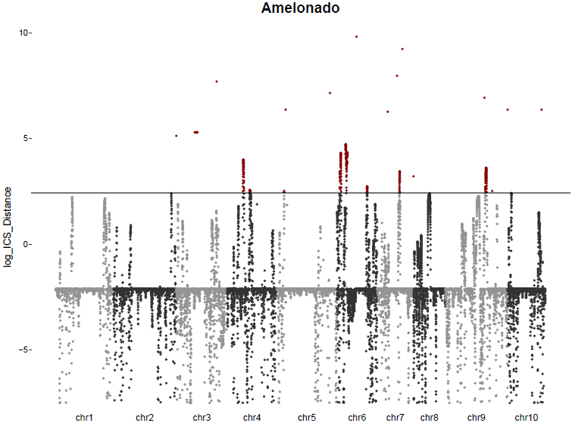
Results: tables and figures

Slide 18
Results – genes under selection (step 2)
Total = 6,055 genes

Slide 19
Results – Genes under selection (step 2)
Criollo
N = 4
Guianna
N = 5
N = 10
N = 9
Curaray
Nanay
Contamana
N = 7
N = 9
Nacional
Iquitos
N = 4
Purús
Marañon
N = 6
Amelonado
N = 14
N = 11
DRL23 - Inhibits germination of fungal spores
RPS5 - Disease resistance protein (Pseudomonas syringae)

Slide 20
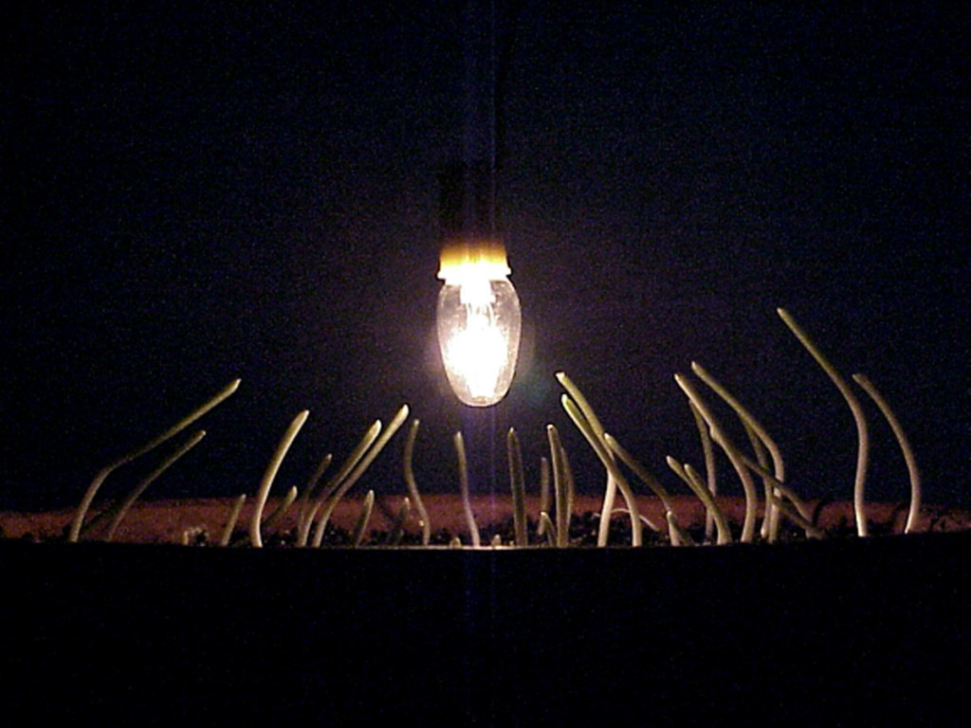
Results – Genes under selection (step 2)
Criollo
N = 4
Guianna
N = 5
N = 10
N = 9
Curaray
Nanay
Contamana
N = 7
N = 9
Nacional
Iquitos
N = 4
Purús
Marañon
N = 6
Amelonado
N = 14
N = 11
AX10A - Auxin-activated signaling pathway
GID1B - Controls root growth, seed germination, and flower development

Slide 21
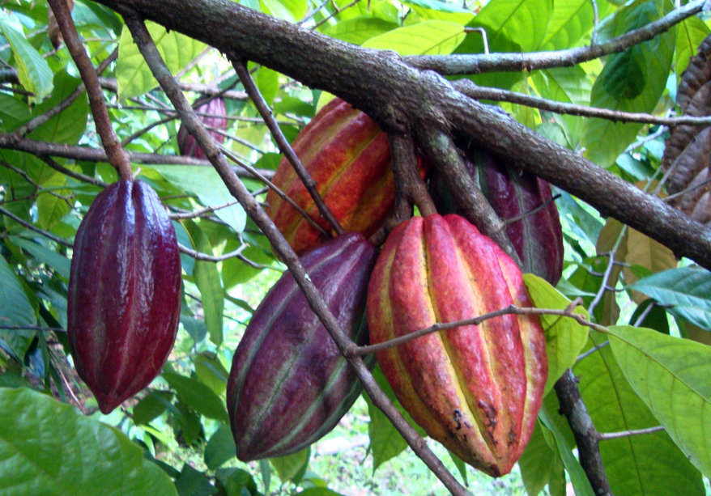
Summary
Are there regions of the genome under selection?
What genes are involved and how many?
4,430 regions of the genome under selection
6,055 genes
Many genes involved with disease resistance and stress responses
Many other genes, including plant development, root growth and flower timing
Conclusions
1. Show genomic evidence to how cacao populations are locally adapting to different environmental stressors.
2. Provides more information that could be utilized for management purposes (resource management and selective breeding).
Notes:
For the last statement, think about disease resistance vs. chocolate quality and vice versa.

Slide 22
Questions?

